Slide 1
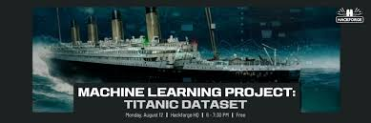
TITANIC SURVIVOP PREDICTION
USING MACHINE LEARNING ALGORITHM
Presented By:
Aman kumar

Slide 2
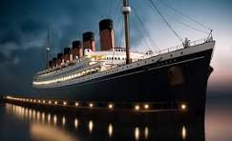
INTRODUCTION
The Titanic Problem is based on the tragic sinking of the 'Unsinkable' Titanic in early 1912. The dataset includes information about multiple passengers, such as their age, gender, number of siblings, points of embarkment, and survival status.

Slide 3
Problem Statement
Based on the features provided for each passenger, the goal is to predict whether a given passenger would survive the sinking of the Titanic. This classification task uses multiple data points to make survival predictions.
Total Rows: 891
Key Features:
Survived: Binary target variable (0 = No, 1 = Yes)
Age: Continuous feature
Fare: Continuous feature
Pclass: Categorical (Passenger Class)
Sex: Categorical (Male/Female)
SibSp & Parch: Family size
Embarked: Port of Embarkation (C = Cherbourg, Q = Queenstown, S = Southampton)
Missing Values: Age, Cabin, Embarked columns have missing data.

Slide 4
Data Preprocessing
Missing Data Handling:
Age: Imputed using median age for each passenger class.
Embarked: Missing values filled with the most frequent value..
Feature Engineering:
Created FamilySize by combining SibSp and Parch.
Dropped irrelevant features: Cabin, Ticket, etc.
Scaling: Applied standardization to Age and Fare to bring them to a common scale

Slide 5
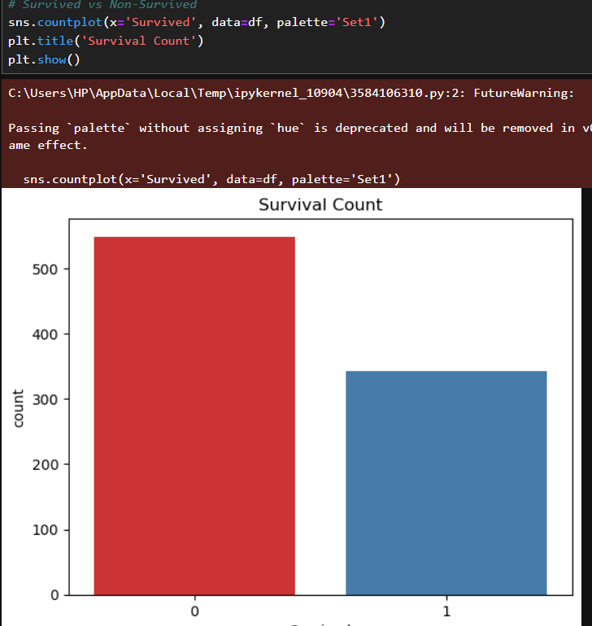
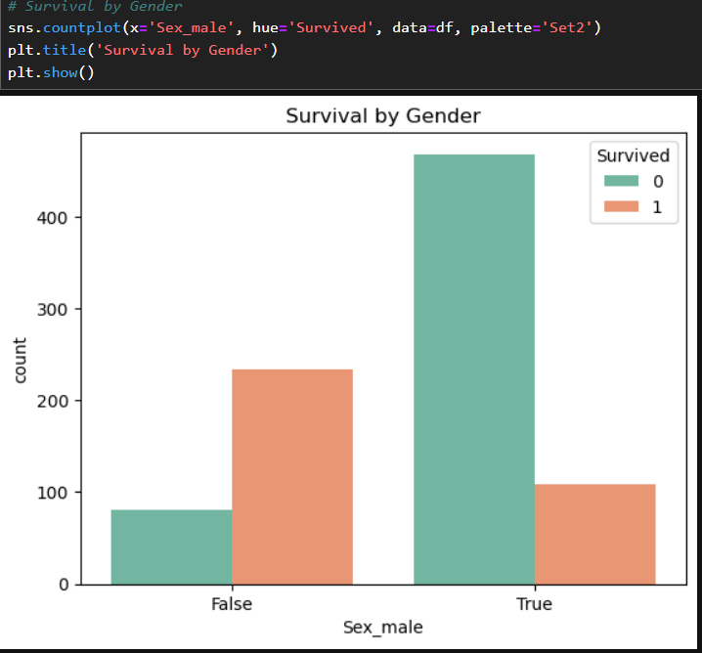
EDA( Exploratory Data Analysis)

Slide 6
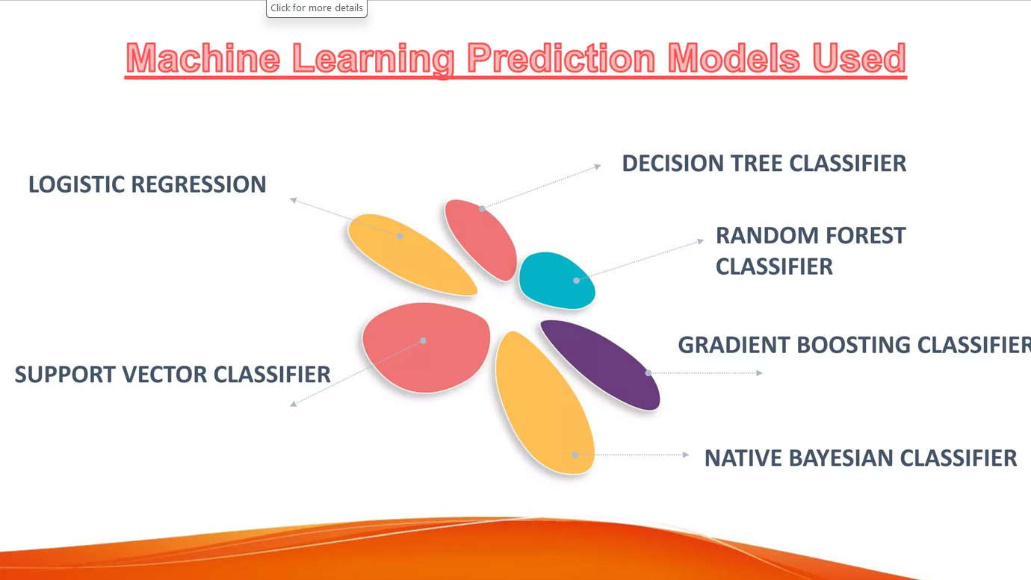
Machine learning models

Slide 7
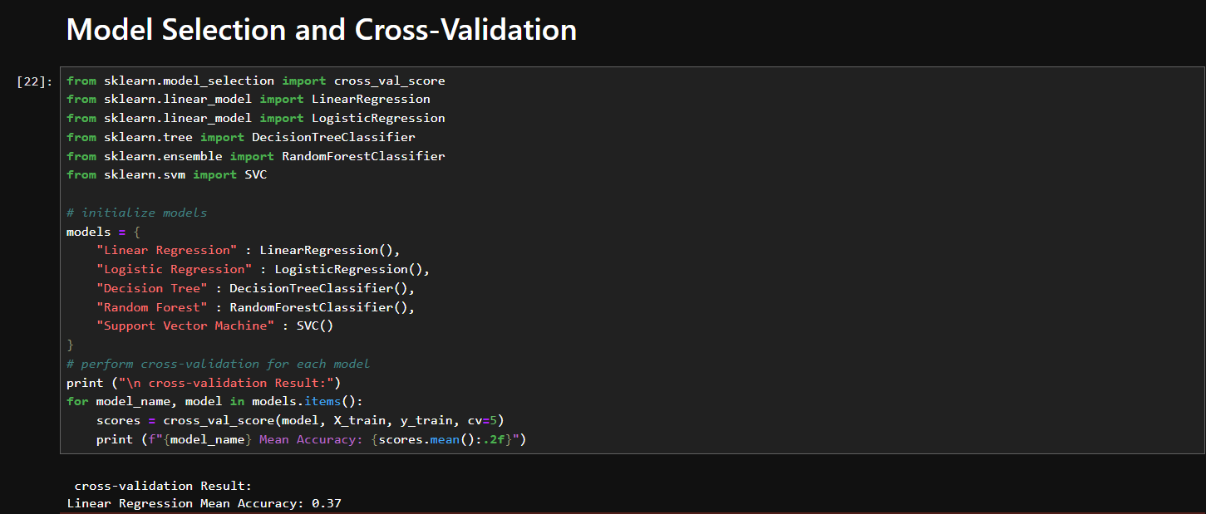
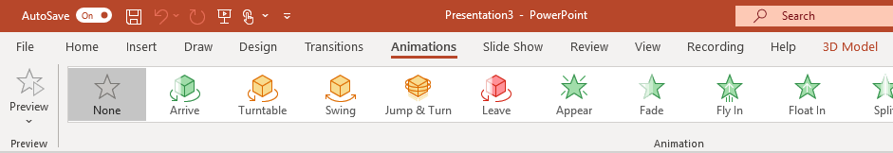
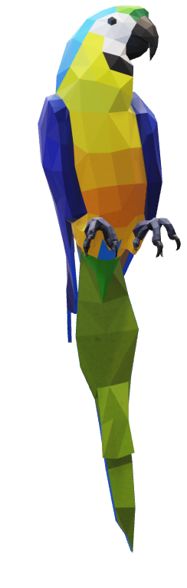
Model Selection :
Try it yourself with the parrot on the right:
1
Select the 3D Model on the right, then go to Animations > Turntable
Hint: Effect Options gives you even more options for Turntable.
2
Explore the other new animations designed specifically for 3D models: Arrive, Swing, Jump & Turn, and Leave.
3
Click Add Animation to combine the new 3D animations with other classic 2D animations, such as Fade, Grow/Shrink, or one of the many Motion Paths animations to test and see what is possible.

Slide 8
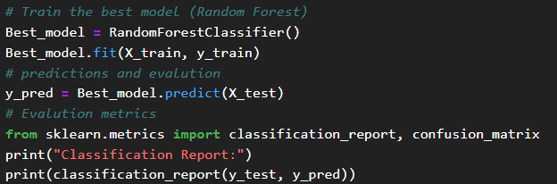
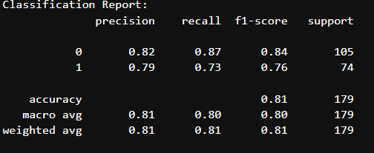
Random Forest

Slide 9
THANK YOU

